Slide 1
DBSCAN (Density-Based Spatial Clustering of Applications with Noise)

Slide 2
Introduction
DBSCAN (Density-Based Spatial Clustering of Applications with Noise) is a popular density-based clustering algorithm used in data mining and machine learning.
Unlike traditional clustering algorithms like k-means, which assume clusters are spherical and require you to specify the number of clusters beforehand, DBSCAN focuses on the density of points to form clusters and is able to discover clusters of arbitrary shapes.

Slide 3
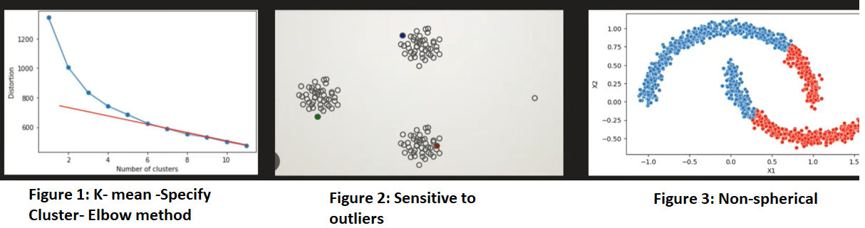
Why we need DBSCAN

Slide 4
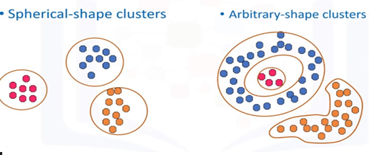
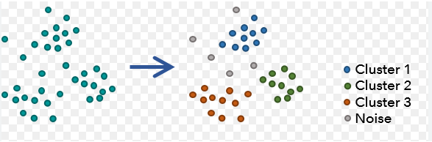
Density Based Clustering
Density-based clustering algorithms, like DBSCAN, work by identifying dense regions of data points and forming clusters based on the density rather than predefined centroids or shapes.
In the visual, regions of higher density represent clusters, while regions with sparse points are either classified as noise or not included in any cluster. Points that are far from others might be labeled as outliers.

Slide 5
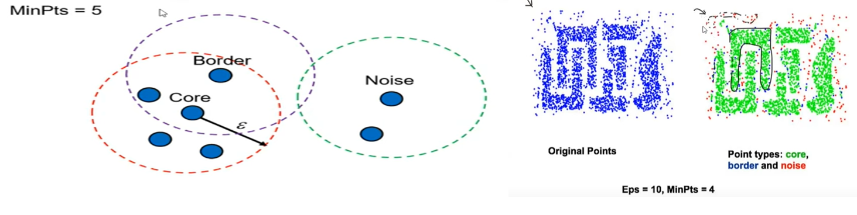
Core Point, Border Point & Noise Point (Outlier)
Core points: Epsilon (ε) – neighbor point>=minpt.
Border points: No.of point less than minpoint and one corepoint as neighbor.
Noise Points: no core point and no border point

Slide 6
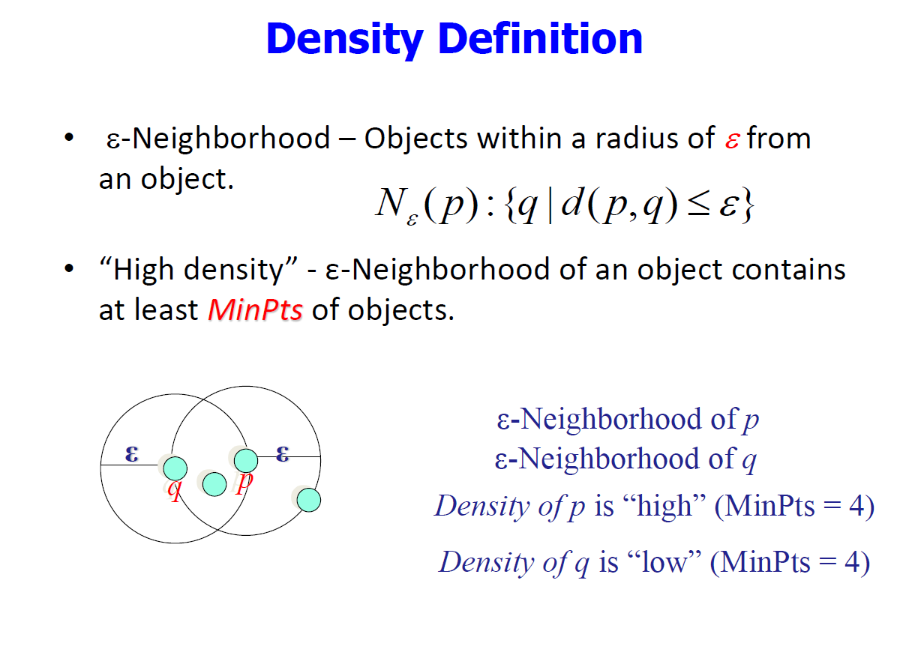

Slide 7
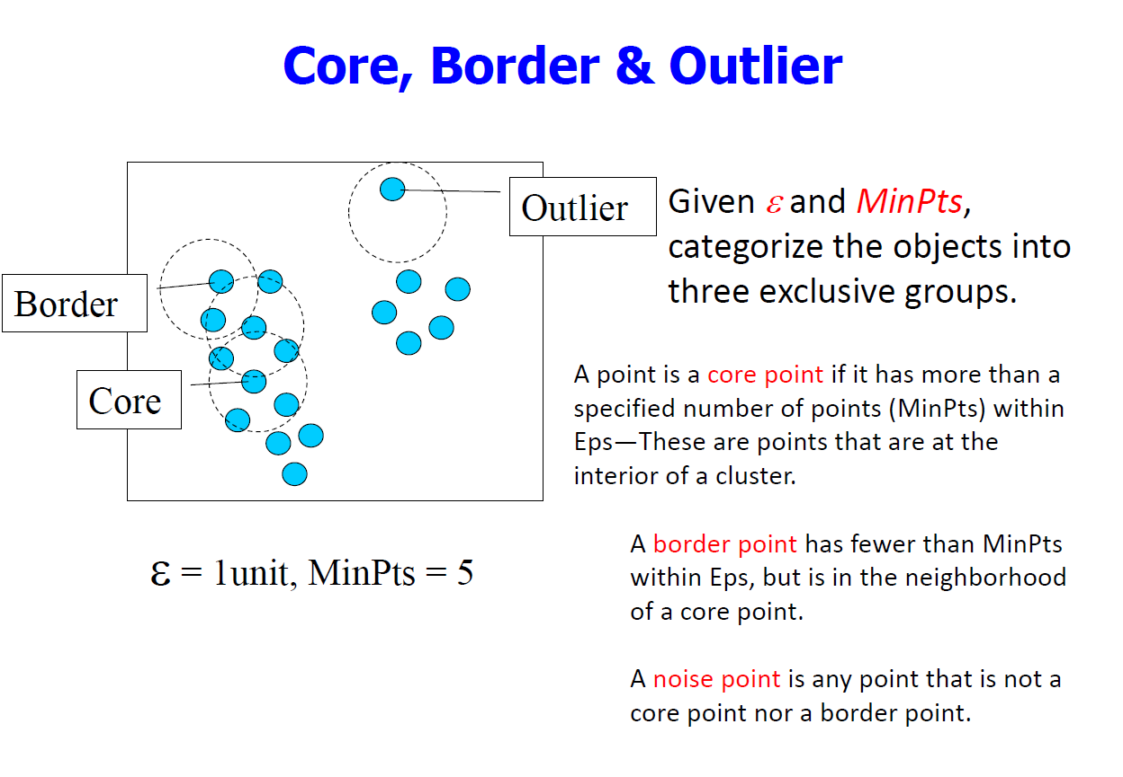

Slide 8
Key Concepts in DBSCAN
Epsilon (ε): This is the radius around a data point within which other points are considered neighbors.
MinPts: This parameter specifies the minimum number of points required to form a dense region (i.e., a cluster).
Core Point: A point is considered a core point if it has at least MinPts neighbors within the distance ε.
Border Point: A point that has fewer than MinPts neighbors but lies within the neighborhood of a core point
Noise Point (Outlier): A point that is neither a core point nor a border point, essentially meaning it doesn't belong to any cluster.

Slide 9
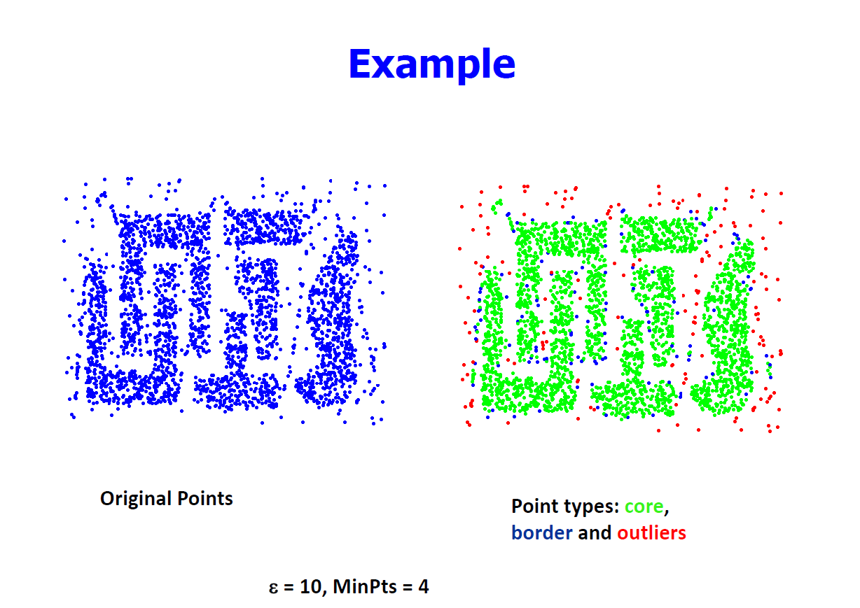

Slide 10
Density Connected Point
“Density-connected points" refer to points that are linked based on a core point's neighborhood, where each point can reach others through a chain of neighboring points that meet the algorithm's density criteria.
Here's a quick breakdown of density-connected concepts:
Direct Density Reachability: A point p is directly density-reachable from q if p is within the ε-neighborhood of q and q is a core point (meaning it has at least MinPts neighbors).
Density Reachability: A point p is density-reachable from q if there exists a chain of points p1, p2, ..., pn where each point in the chain is directly density-reachable from the next.
Density Connectivity: Two points p and q are density-connected if there exists a third point r such that both p and q are density-reachable from r.

Slide 11
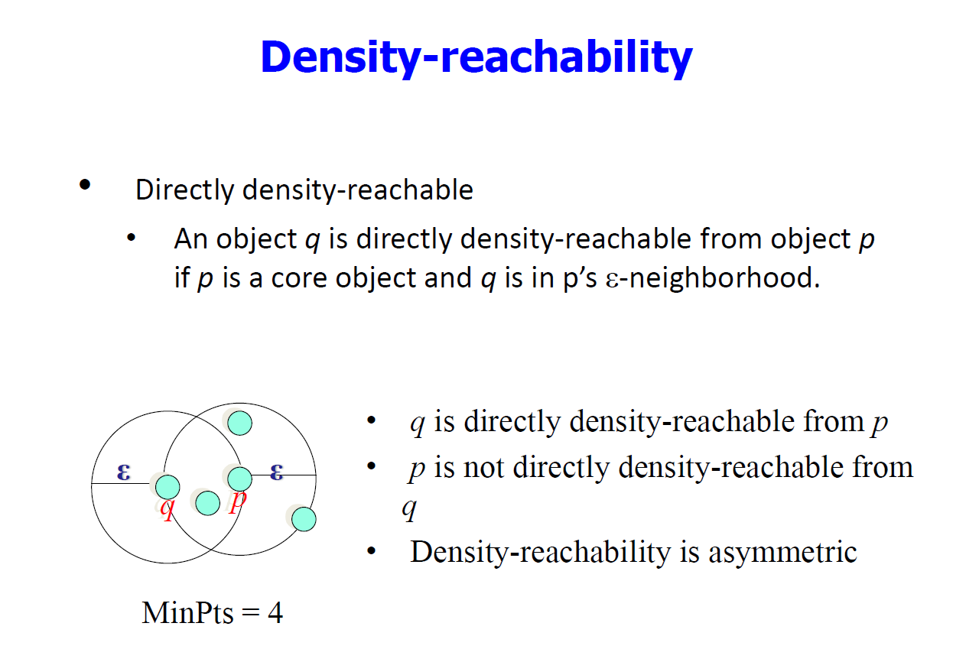

Slide 12
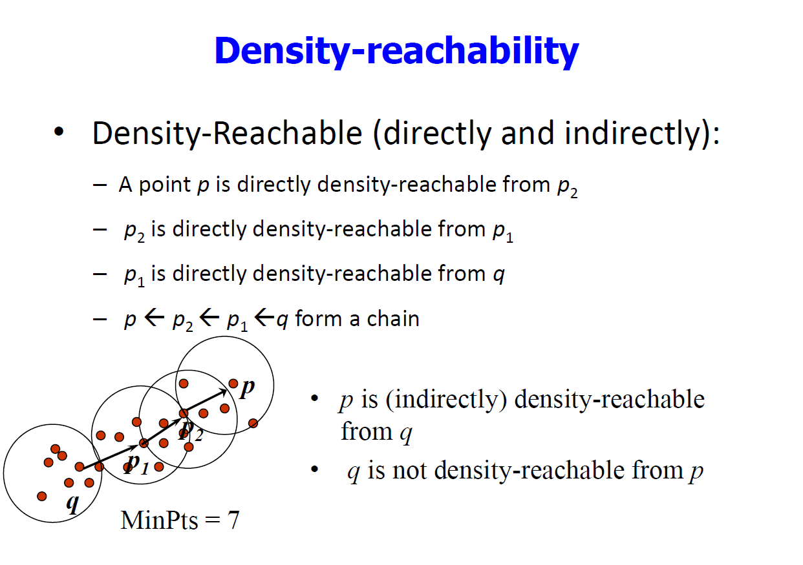

Slide 13
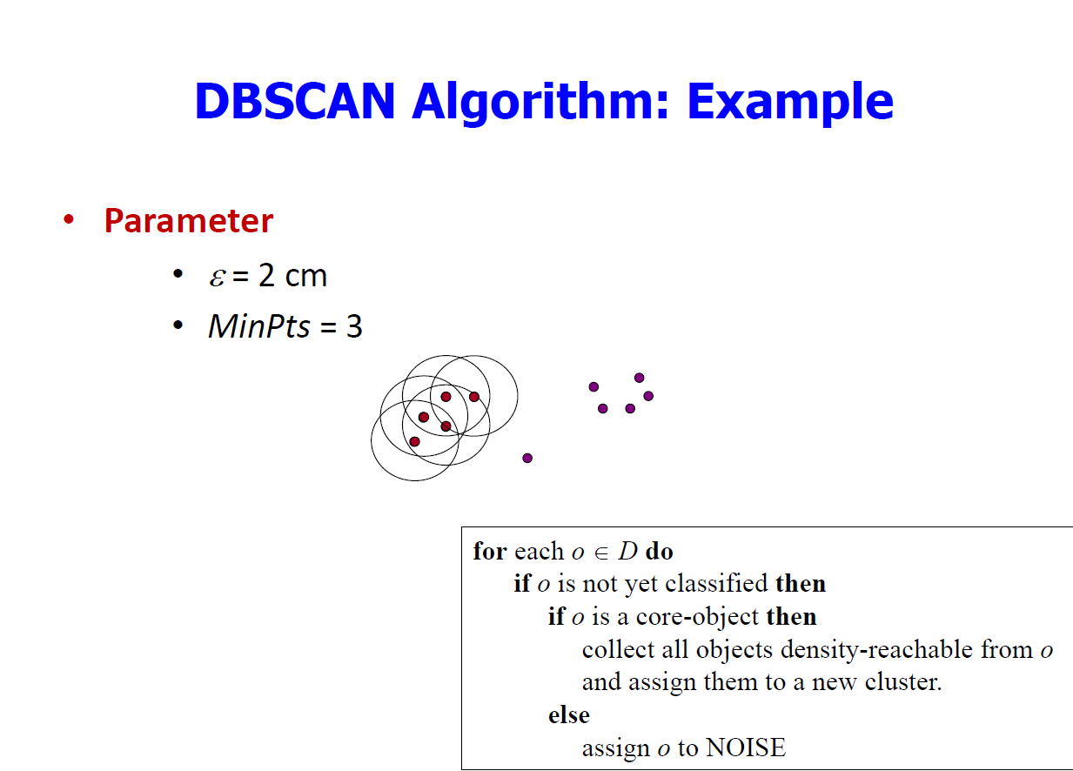

Slide 14
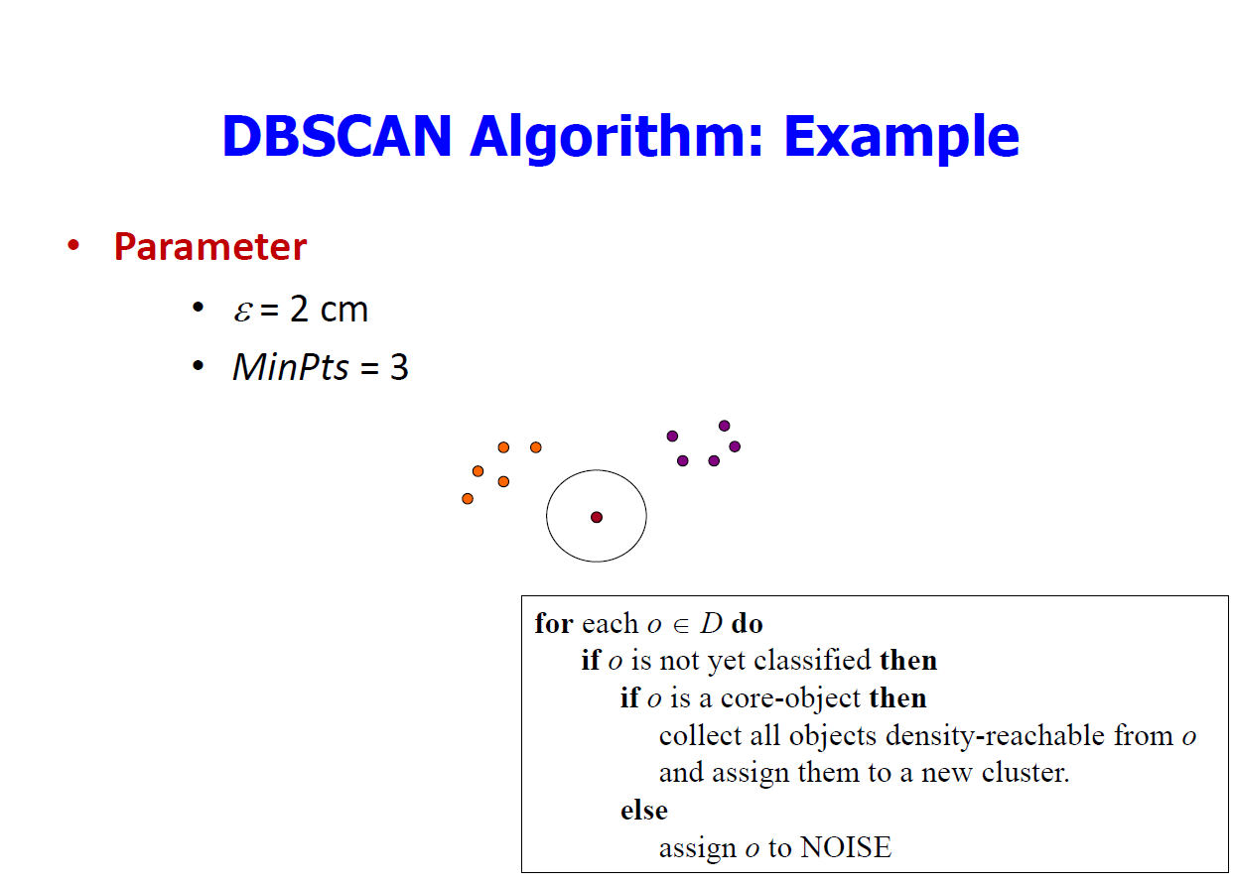

Slide 15
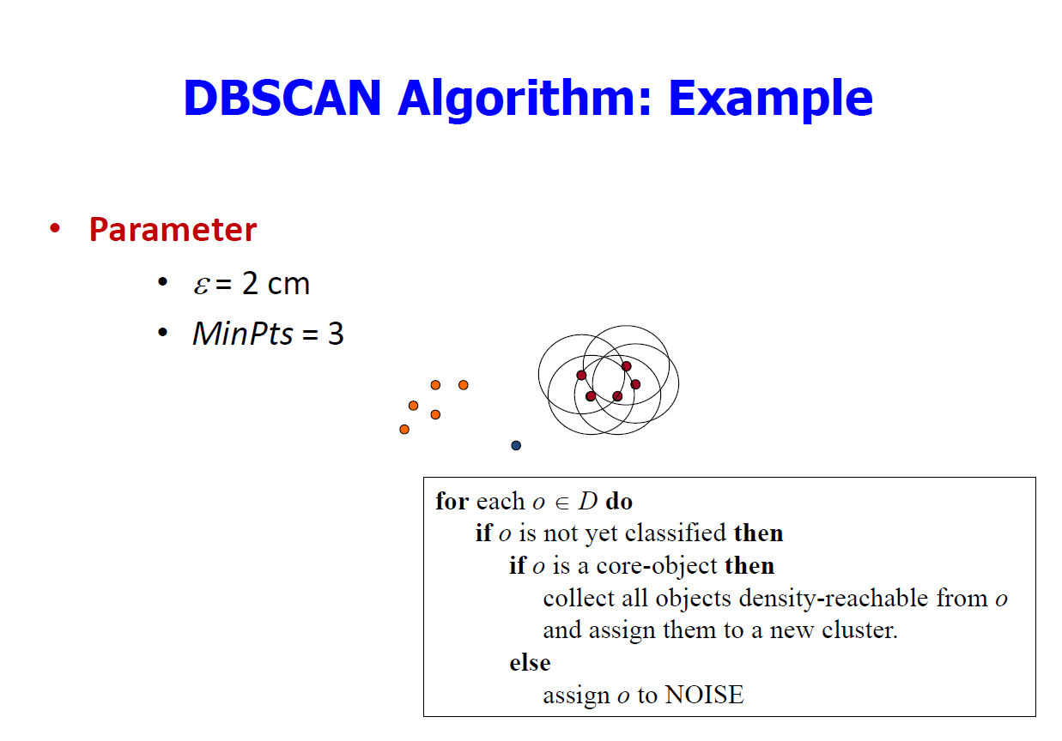

Slide 16
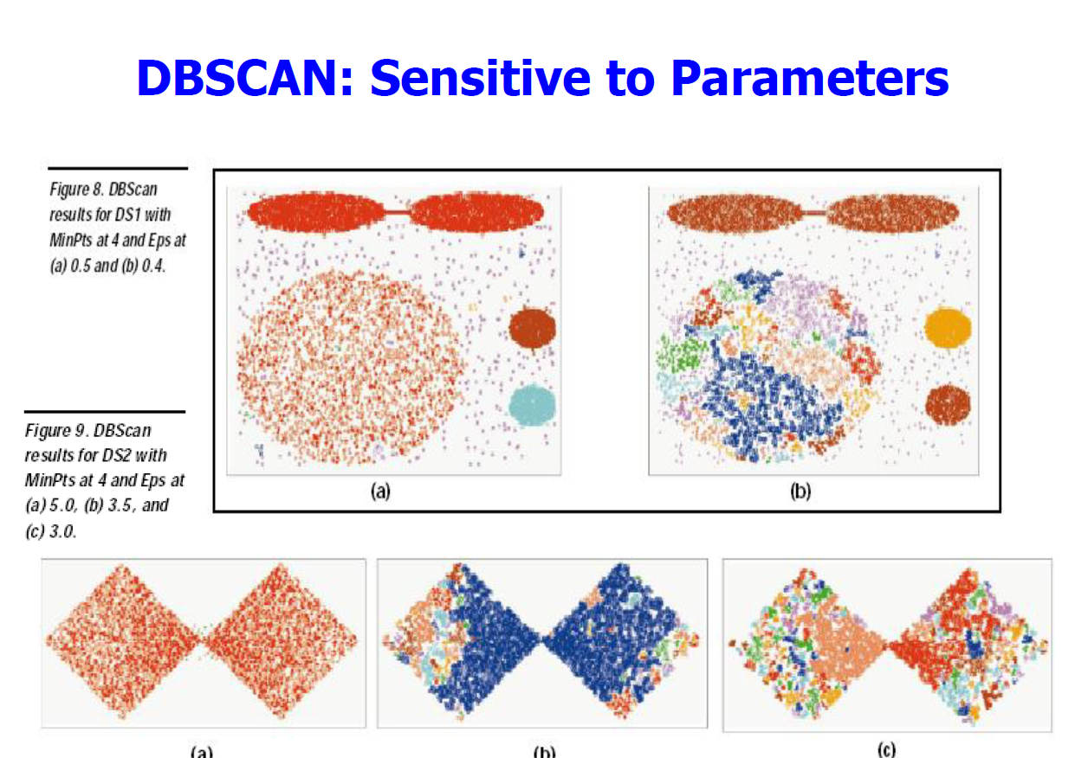

Slide 17
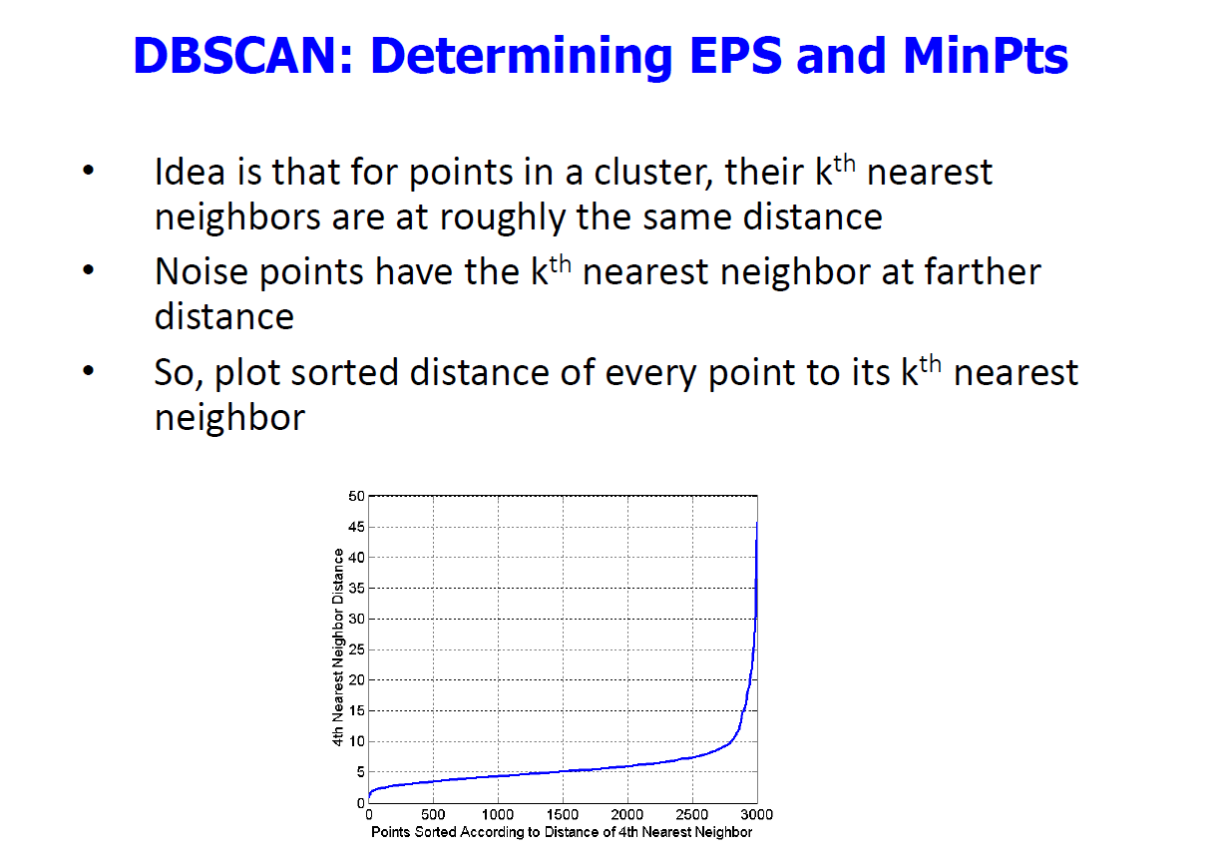

Slide 18
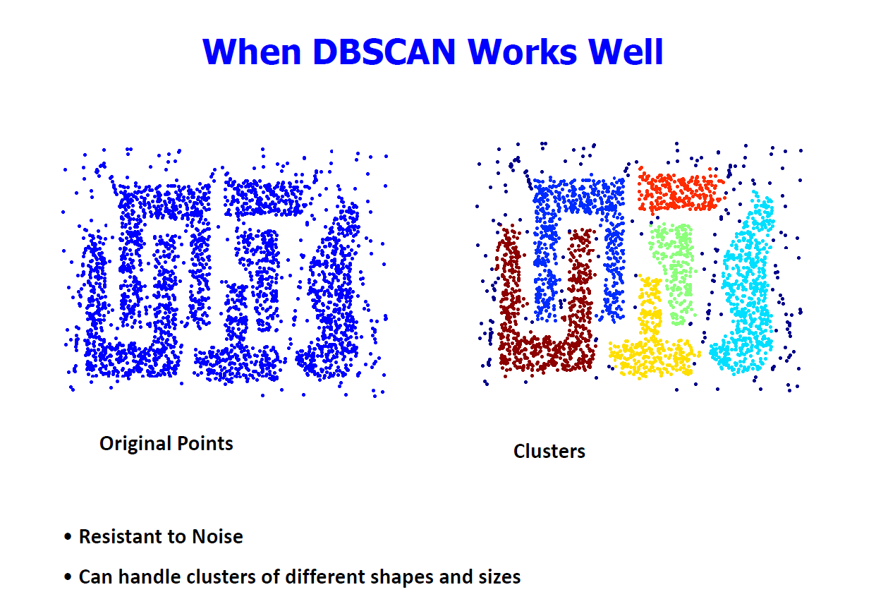

Slide 19
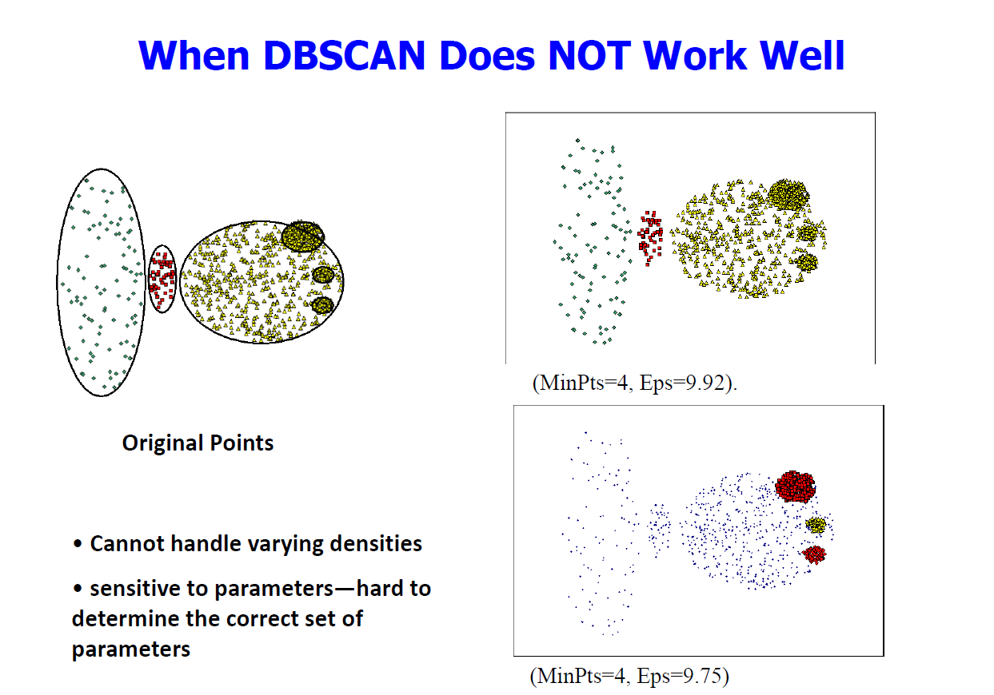

Slide 20
visualizing-dbscan-clustering
https://www.naftaliharris.com/blog/visualizing-dbscan-clustering/

Slide 21
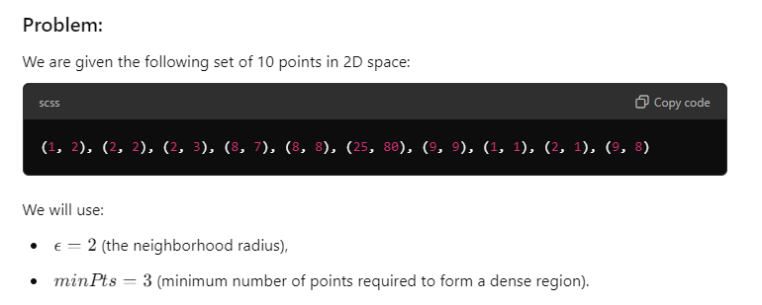
Problem-1

Slide 22
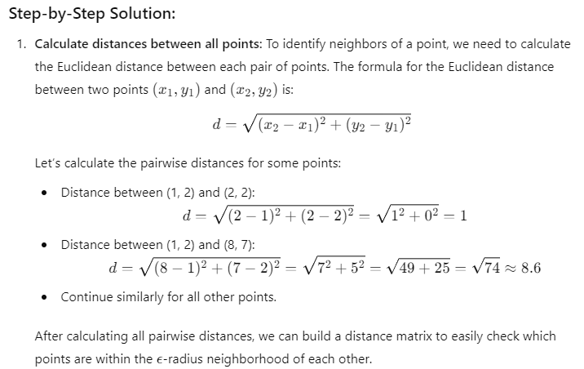
Solution

Slide 23
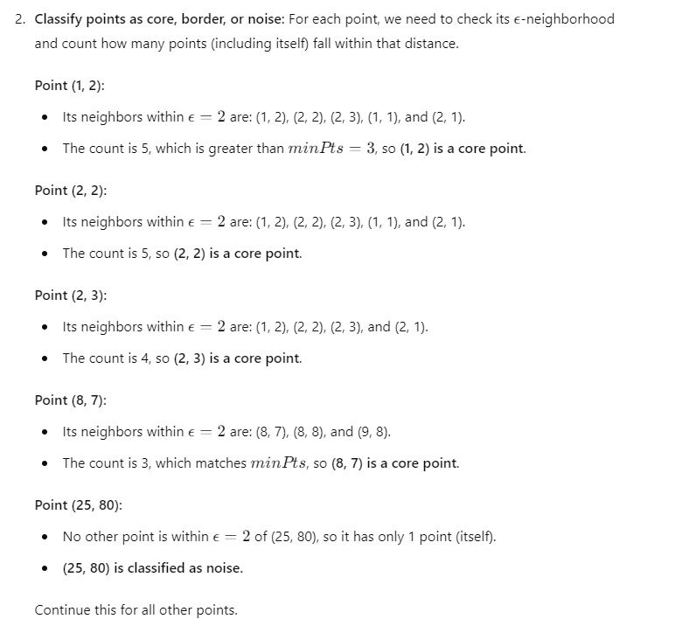

Slide 24
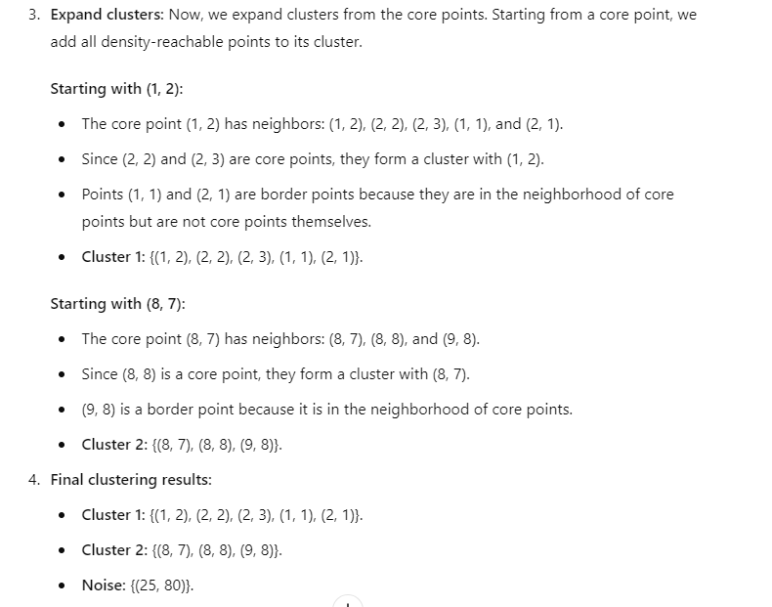

Slide 25
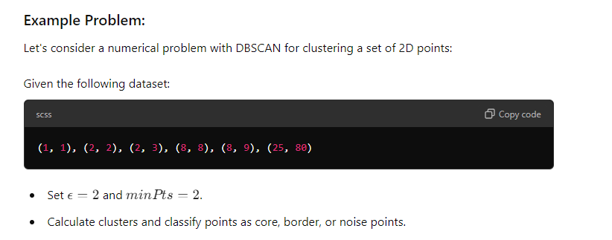
Numerical problem-2

Slide 26
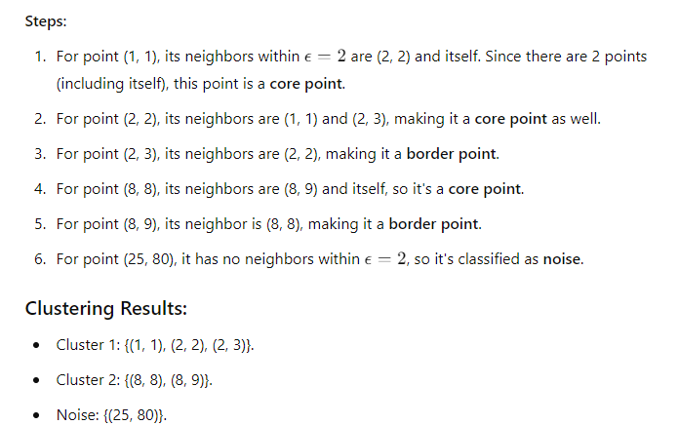
solution

